Slide 1
HNFE M.S. Milestones
Degree requirements
2021-2022*
*With updates for spring 2022

Slide 2
Purpose:
Describe the milestones for earning an M.S. in HNFE

Slide 3
M.S. Milestones Overview
Convene an advisory committee
Submit a plan of study (POS)
Pass the proposal exam
Pass final exam
Submit electronic thesis (ETD)
Complete all coursework on POS
Submit progress report every spring

Slide 4
Advisory Committee
Convene an advisory committee
Submit a plan of study (POS)
Pass the proposal exam
Pass final exam
Submit electronic thesis (ETD)
Complete all coursework on POS
Submit progress report every spring

Slide 5
Advisory Committee
Purpose | What | How (Process) | When
Provide guidance and assistance for thesis research Assess student’s progress Approve POS | Committee comprised of at least 3 members Advisor serves as chair 2 HNFE grad program faculty members + 1 faculty member from another VT department or 1 external member not affiliated with VT HNFE grad program faculty must comprise 50% | List committee members on the POS form For external committee members, submit the Graduate Committee Service Approval form to A. Steketee and L. Jones Submit Change of Committee-Advisor form if committee changes | By the end of the 2nd semester
Find all forms on the M.S. HNFE webpage under “Resources & Forms”

Slide 6
Plan of Study (POS)
Convene an advisory committee
Submit a plan of study (POS)
Pass the proposal exam
Pass final exam
Submit electronic thesis (ETD)
Complete all coursework on POS
Submit progress report every spring

Slide 7
Plan of Study (POS)
Purpose | What | How (Process) | When
Delineate the courses a student will take to complete requirements of HNFE and the Graduate School | Minimum of 30 total credits Minimum of 20 course credits Minimum of 6 research credits Minimum of 3 graduate statistics credits HNFE 5204 Translational Science 4 components of Ethics, Integrity, Diversity and Inclusion training More details on Complete Coursework slide | Option: Draft the plan on the Plan of Study worksheet Submit the online POS form from which a pdf will be generated, checked by L. Jones, and sent to you Obtain committee members’ signatures on the pdf Return signed pdf to L. Jones Submit Plan of Study Change form if your plan changes | Submit POS by the end of the 2nd semester Email certificate(s) of either VT Institutional Review Board Human Subjects Protections Tutorial training and/or VT Institutional Animal Care and Use Committee to L. Jones in your first semester (1 component of the Ethics & Integrity requirement)
Find all forms on the M.S. HNFE webpage under “Resources & Forms”

Slide 8
Coursework
Convene an advisory committee
Submit a plan of study (POS)
Pass the proposal exam
Pass final exam
Submit electronic thesis (ETD)
Complete all coursework on POS
Submit progress report every spring

Slide 9
Coursework: > 30 credits as listed on POS
Research credits
(6 minimum)
HNFE 5994
No transfer credits from other degrees
Ethics, Integrity, Diversity and Inclusion* Requirement
(4 components)
Human Subjects Protections Tutorial from the VT Institutional Review Board and/or VT IACUC training (email certificates to L. Jones)
ALS 5324 Research Ethics in Agriculture & Life Sciences (Fall only, 1 cr)
GRAD 5014 Academic Integrity and Plagiarism (2 cr)
Course credits
(20 minimum)
All courses must be completed with C- or better
No audit courses; pass/fail only if that’s the only way a course is offered
Translational Science (4 cr) and Statistics (3 cr)
Max of 50% of credits can be transferred from other grad programs
Max of 6 credits from 4000 level and 6 credits from Independent/Special Study
ALS 5984 Building Multicultural Competence in Agriculture & Life Sciences (1 cr)*
*The diversity and inclusion training is required for students whose initial enrollment is Spring 2022 or beyond.

Slide 10
Proposal Exam
Convene an advisory committee
Submit a plan of study (POS)
Pass the proposal exam
Pass final exam
Submit electronic thesis (ETD)
Complete all coursework on POS
Submit progress report every spring

Slide 11
Proposal Exam
Purpose | What | How (Process) | When
Propose thesis research project Demonstrate critical thinking and ability to conduct literature review and design one or more research studies | Research proposal document (see ETD Guidelines on the VT library website and recommended structure in HNFE M.S. Handbook) Public oral presentation + closed door session with advisory committee | Decide specific format of the document with advisor and committee Obtain feedback from advisor on draft(s) At least two weeks before the exam: (1) submit final document to the committee and (2) email title, committee member names, abstract*, and meeting details to L. Jones Committee will evaluate the exam as pass/fail | No later than the 3rd semester Not within the same semester as the final exam One full semester (at least 15 weeks) must elapse before a student who fails an exam can try again
*Word document to L. Jones

Slide 12
Final Exam
Convene an advisory committee
Submit a plan of study (POS)
Pass the proposal exam
Pass final exam
Submit electronic thesis (ETD)
Complete all coursework on POS
Submit progress report every spring

Slide 13
Final Exam: “Defense”
Purpose | What | How (Process) | When
Defend the thesis: demonstrate support for the claims, procedures, and results | Written document (ETD) that adheres to the Graduate School Electronic Thesis and Dissertation (ETD) guidelines Public oral presentation + closed door “defense” with advisory committee | Review ETD iThenticate score with your advisor At least two weeks before the exam: (1) schedule the exam with the grad school through the electronic signature system (ESS), (2) send the ETD to your committee, and (3) email title, committee member names, abstract*, and meeting details to L. Jones Committee will evaluate the exam as pass/fail | 4th semester Deadlines for applying for degree will be published on the Graduate School “Deadlines for Academic Progress” webpage See the handbook for items to check in your 4th semester
*Word document to L. Jones

Slide 14
Electronic Thesis (ETD)
Convene an advisory committee
Submit a plan of study (POS)
Pass the proposal exam
Pass final exam
Submit electronic thesis (ETD)
Complete all coursework on POS
Submit progress report every spring

Slide 15
Electronic Thesis (ETD)
Purpose | What | How (Process) | When
Submit final thesis document to the Graduate School to be approved and archived | Final electronic thesis document (ETD) with updates and edits based on committee feedback in the final exam | Edit thesis document based on committee feedback in the final exam Run the final document through iThenticate and ensure score is below 15% Submit the document and iThenticate score to the Graduate School through the electronic signature system (ESS) within two weeks of your final exam. | Within two weeks of the final exam (“defense”)

Slide 16
Annual Progress Reports
Convene an advisory committee
Submit a plan of study (POS)
Pass the proposal exam
Pass final exam
Submit electronic thesis (ETD)
Complete all coursework on POS
Submit progress report every spring

Slide 17
Annual Progress Report
Purpose | What | How (Process) | When
Track progress and achievements Identify areas to improve Adhere to Graduate School requirements | Electronic progress report | Submit the online annual progress report from which a pdf will be generated and sent to you and your advisor Your advisor will add his, her, or their evaluation Obtain committee members’ signatures on the pdf Return signed pdf to L. Jones by designated date | End of spring semester (usually around May 1) Leave enough time for your advisor to write an evaluation and to obtain committee members’ signatures
Find annual progress report form on the M.S. HNFE webpage under “Resources & Forms”

Slide 18
Milestones are the minimum requirement
Annual advisory committee meeting—if proposal and final exams don’t occur
Detailed timeline beyond POS
Participation in enrichment activities: seminars, conferences, fellowships
Presentation at conferences
Publication in peer-reviewed journals

Slide 19
Forms for Special Circumstances
Change of degree from M.S. to Ph.D.
Independent Study
L. Jones will register you after receiving your form
Start of Semester Defense Exception (SSDE)
The Graduate School will register you for 1 credit after receiving your form

Slide 20
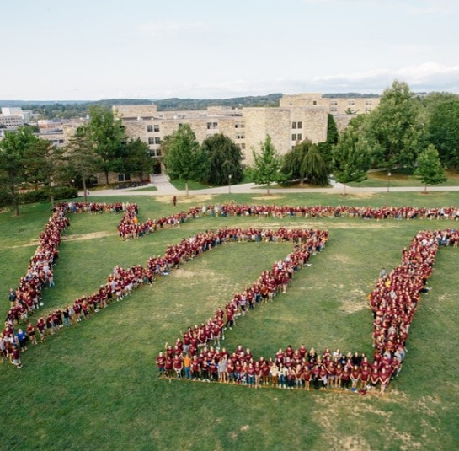
Reminder:
Find all details in the HNFE M.S. Handbook and VT Graduate School Catalog
Contacts:
Dr. Robert Grange
Interim Graduate Program Director
rgrange@vt.edu
Lisa Jones
Graduate Program Coordinator
lijones5@vt.edu

